Slide 1


6th European Energy Forum :
What business model for energy in Europe ?
Session 6 : When local authorities are becoming smart
May 23, 2017 - Conseil Français de l’Energie

Slide 2

Good Data for Smart Planning : regional observatories spearheading the energy data turn
Juliette DIXON, Coordinator of the National Network of Regional Energy and Environment Agencies

Slide 3
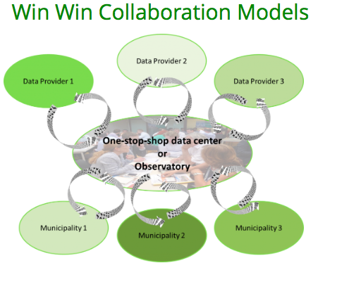

Help identify & target right
14 Regional agencies in France
Regional energy 30 GHG & energy data observatories in
Europe :
« one-stop shop »
services
to public authorities
“DATA4ACTION”
European project

Slide 4
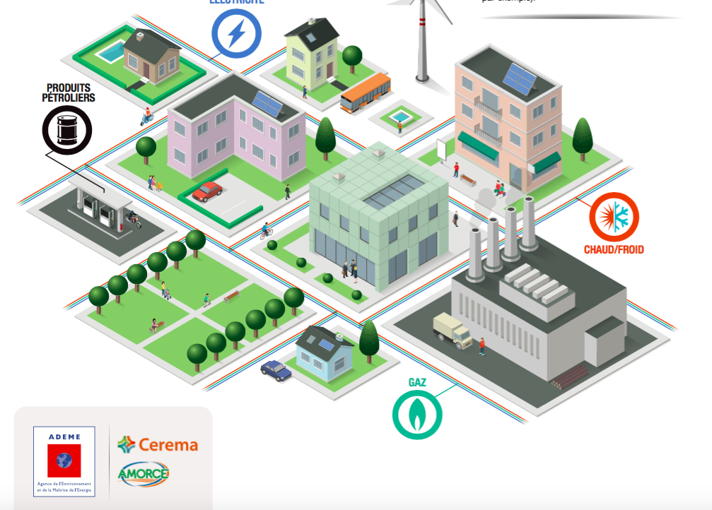
Access to energy data : why ?
Monitoring of the laws’ objectives : Grenelle I and II, 2015 Energy Transition Law (Art. 179)
Transparency

Slide 5
What’s new ?
Beforehand | From now on
Grenelle II | Energy Transition Law
Costly and negociatied access to data « Hidden data » (commercial sensitivity) Protection of personal data | Mostly free of charge Secret data is unveiled No personal under 11 accommodations

Slide 6
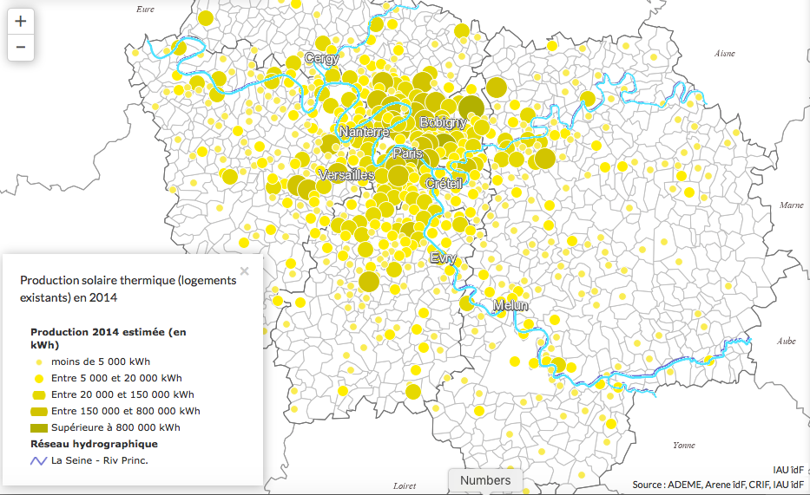
Good data for smart planning
Increasing Renewables
Targeting fuel poverty
Large-scale retroffiting to increase energy savings
Source : ENERGIF (2017)

Slide 7
Thank you for attention
Questions, comments ?
Let us stay in touch : Juliette Dixon : rare@rare.fr

